Slide 2
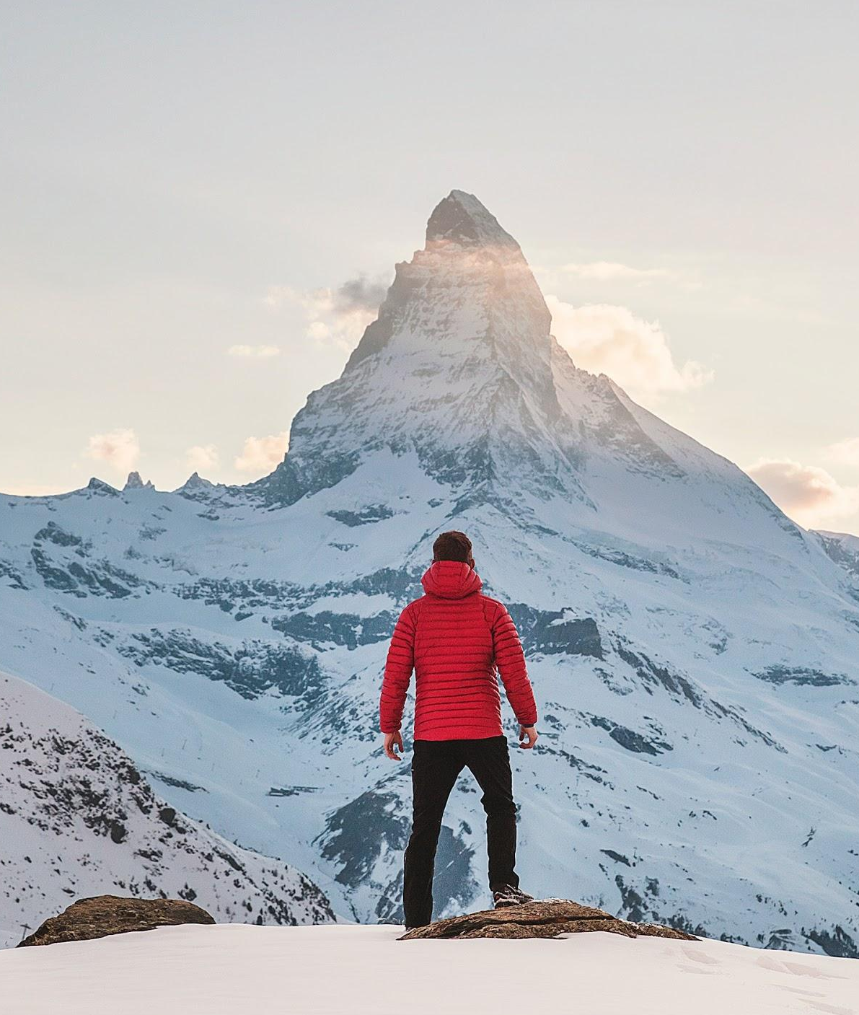
fjlbfgnf fgjkl

